Slide 1
Why chance-constraints
A European generation expansion plan for a CO2 free energy system in 2050
– Quantifying the reliability of renewables in extreme weather events

Slide 2
Storyline Main Idea
Energy systems in EU with a high share of renewables to meet emission targets
Extreme weather events are rising a challenge to a renewable weather dependent supply
At the same time reliability standards have to hold
So there is a multiobjective of building a renewable system to meet emission targets, at low cost, with high reliability – Economic triangle
What we already have:
EU simplified unit commitment model with NTC between countries
Synethtic demand for countries for 2020 -2050
Representative weather years – availability factors
What we can already do:
Construct extreme weather events and investigate effects on the system

Slide 3
Storyline Main Idea - Extension
Planned future capacity based on one representative weather year is not sufficient for the reliable operation of the system for different weather years and extreme weather conditions
We can investigate what is needed in terms of capacity investments to ensure with a certain probability that under extreme weather events predefined goals hold (EENS, LOLH, CO2, Costs)
Additionally, we can implement national expansion goals and force the model to fulfill them to a certain probability
Furthermore, we look at how much, the used weather depending capacity factors, outages, or faults can occur until a critical system level is reached

Slide 4

Optimization with chance constraints
General Problem:
min $f\left(x,ξ\right)$ - objective function with decision vector $x$ and $ξ$ representing the uncertainty vector
s.t. 1 ) $g\left(x,ξ\right)=0$
2) $h\left(x,ξ\right)≥0$
Under chance constraint formulation the inequality constrain is formulated as:
2) $P\left(h\left(x,ξ\right)≥0\right) ≥ α where α ∈[0,1]$ - $α$ is the probability level
An output variable $y(ξ$), that belongs to $x$ is then typically restriced to:
- $P\left(y_{min} ≤y ≤ y_{max}\right)≥α$
Benefits of Chance-constraints:
Chance constraints are useful when taking into account the trade-off between two or more objectives e.g.
CC fo the loss of load probability, EENS or FOR
CC for Emission targets
NTC congestion
Capacity factor assignment for renewables

Slide 5
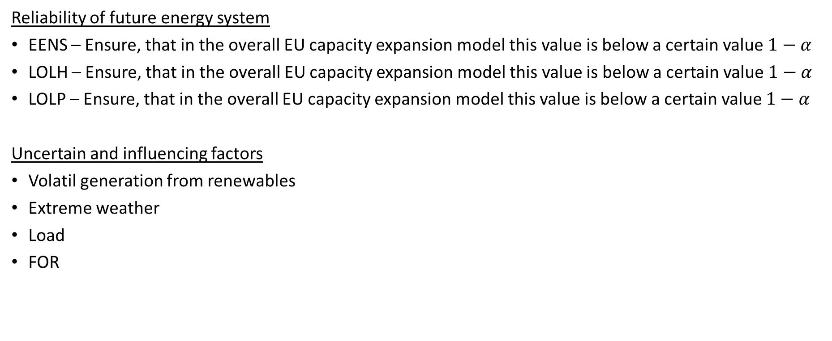
Determining reliability & influencing factors
Reliability of future energy system
EENS – Ensure, that in the overall EU capacity expansion model this value is below a certain value $1−α$
LOLH – Ensure, that in the overall EU capacity expansion model this value is below a certain value $1−α$
LOLP – Ensure, that in the overall EU capacity expansion model this value is below a certain value $1−α$
Uncertain and influencing factors
Volatil generation from renewables
Extreme weather
Load
FOR

Slide 6
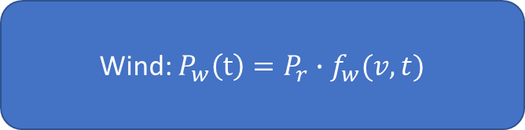
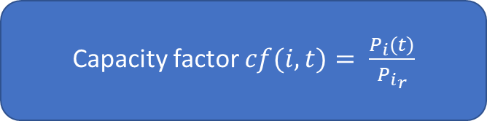
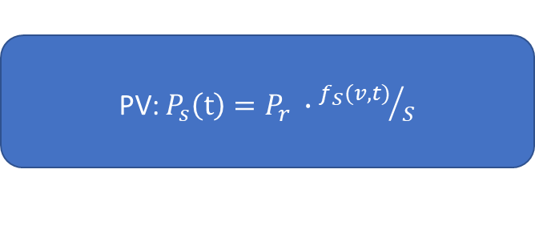
Wind & solar
Pi(t) = actual output power of technology i
Pir = nominal cap of technology i
Capacity factor $cf(i,t)= \frac{P_{i}(t)}{{P_{i}}_{r}}$
fw(v,t) = PDF – Weibull
Weibull = smooth , but not convex
Hub-height not
Wind: $P_{w}\left(t\right)=P_{r}∙f_{w}(v,t)$
fs(v,t) = PDF – Beta for radiation intensity
Beta = smooth & convex
S = Standart radiation intensity, temp not considered
PV: $P_{s}\left(t\right)=P_{r} ∙{f_{S}(v,t)}/S$

Slide 7

Problem formulation
Min total costs
s.t. 1) $\sum_{i=1}^{n}{x_{i=renewable}∙{Cap}_{i=renewable}+…= \sum_{i}^{n}{load} }$
....
s.t. Nr. N) ${P(Gen}_{i} ≥{Cap}_{i=renewable} ∙f_{i=renewable}) ≥ α$
$P\left(EENS≤a value\right)≤1− α$

Slide 8
Stress Test (extrem weather) & comparison
Dunkelflaute
Hydro drought
Ice-Storms
Comparison of results with other expansion plans

